Slide 1

Project Quack
Presented by
The Bestagons
Notes:
Miles

Slide 2
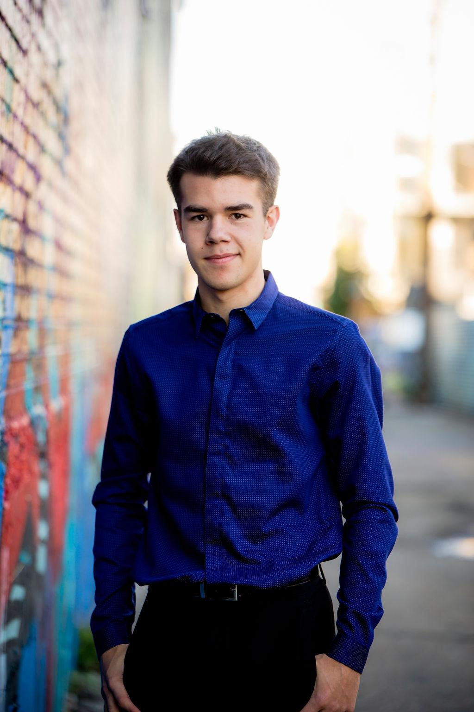


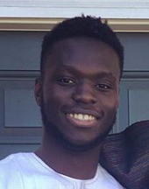

OUR TEAM
Ore Adenikinju
Miles Robertson
Rafael Piloto
Team member
Product Owner
Scrum Master
Notes:
Miles, Ore, Rafael

Slide 3
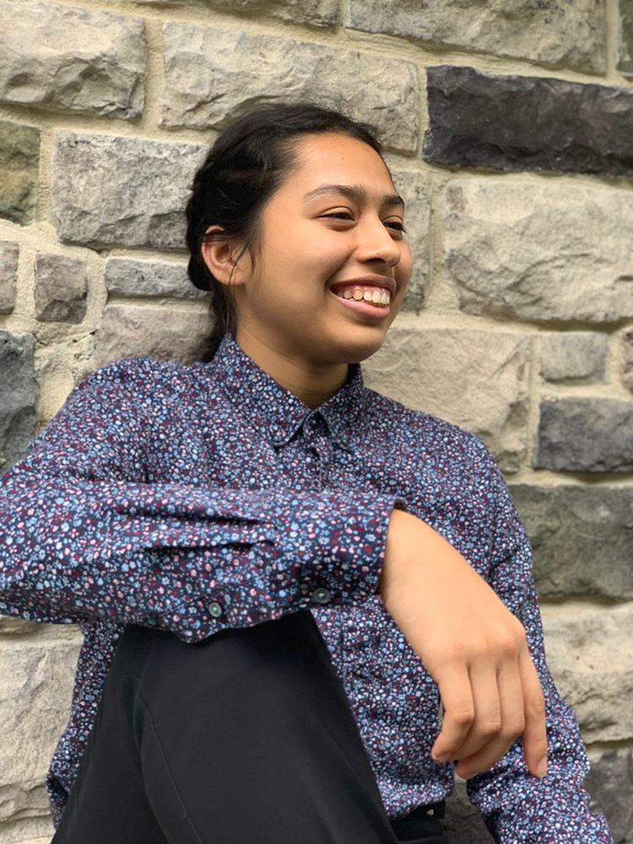
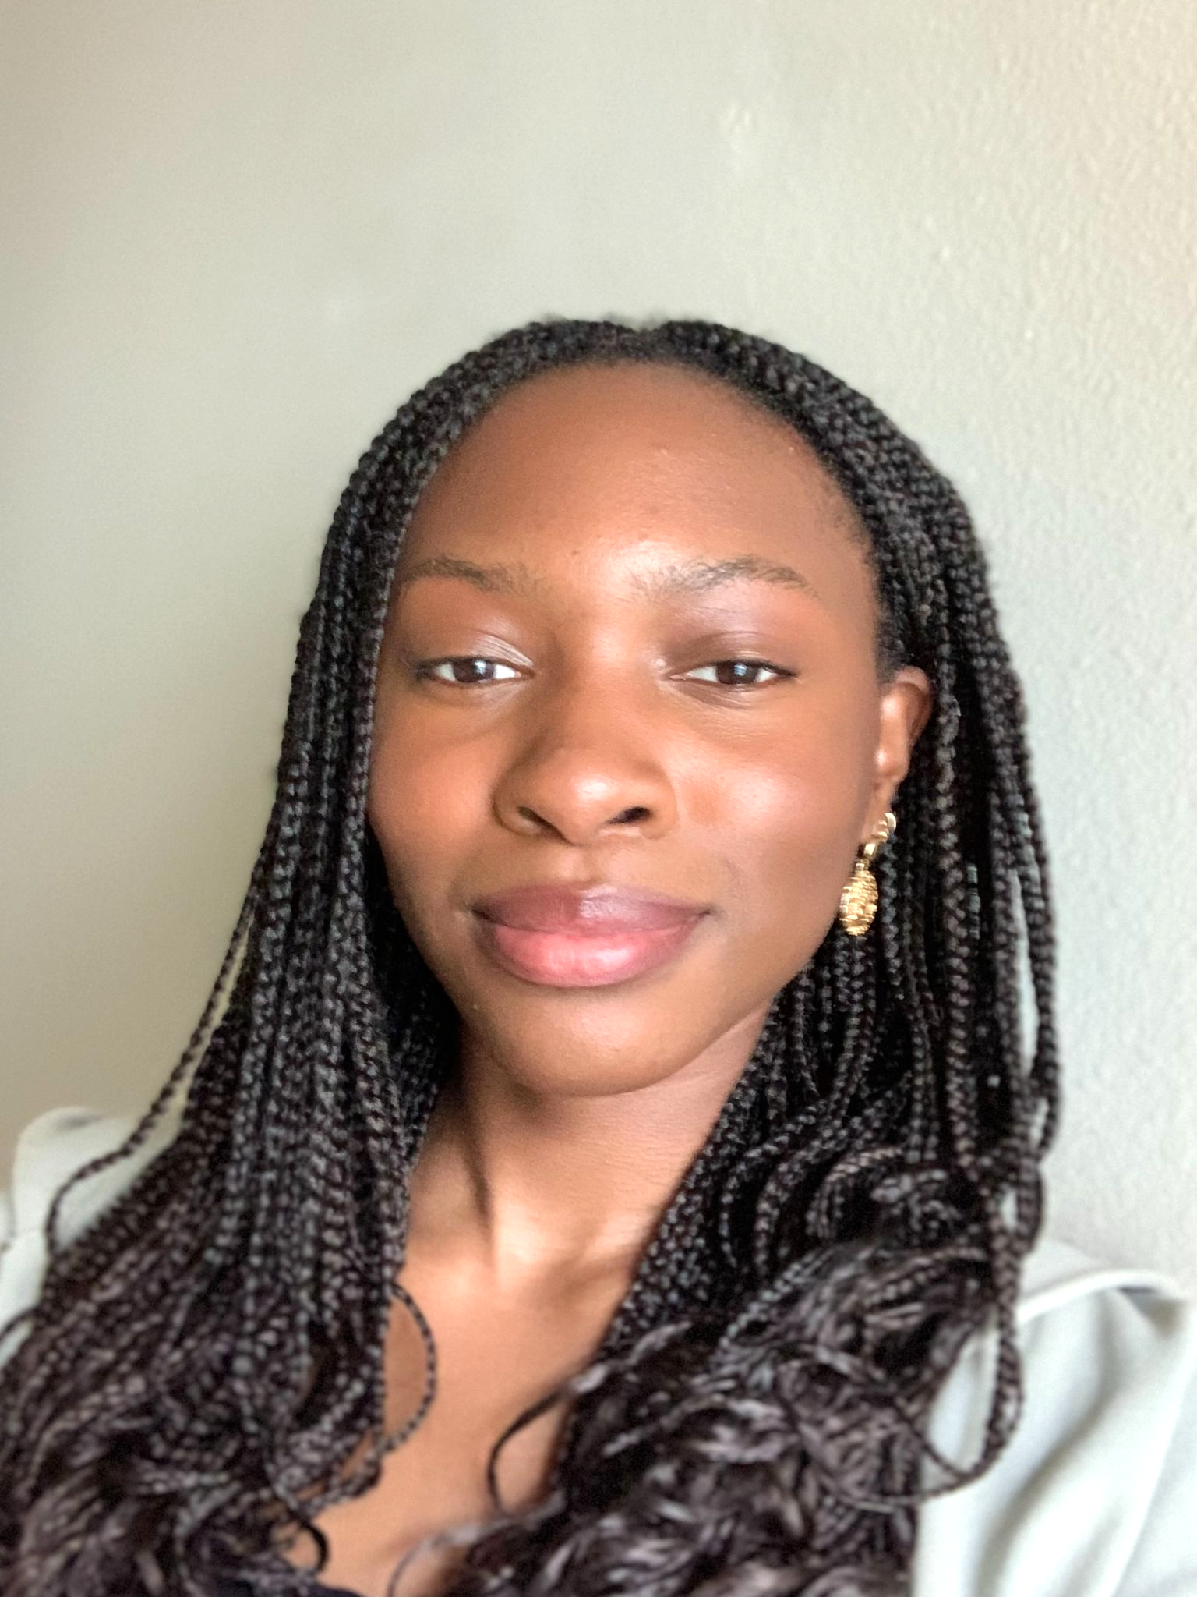
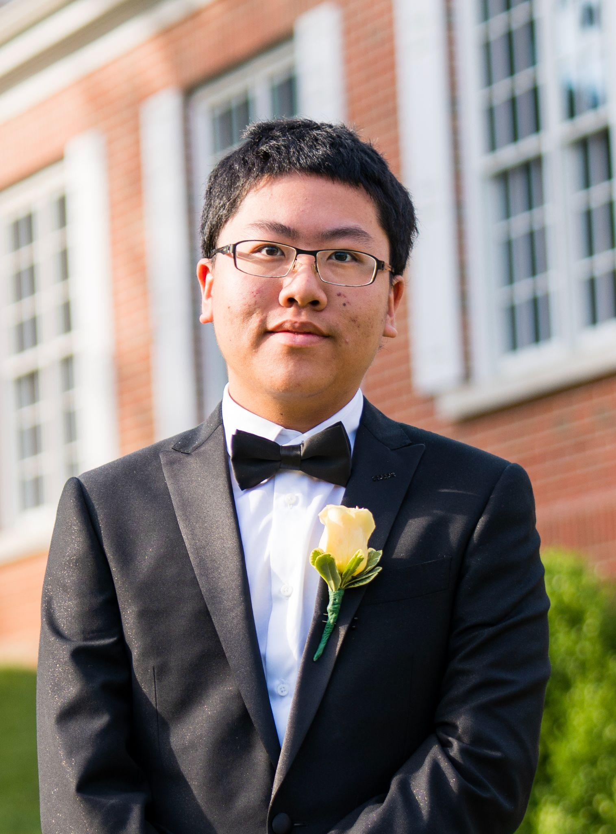
OUR TEAM
Mimi Olayeye
Brenda Cano
David Wei
Team Member
Team Member
Team member

Slide 4
PROBLEM VS OUR SOLUTION (elevator pitch)
PROBLEM
SOLUTION
Returning from a pandemic, Emory University hasn’t quite figured out all the best systems yet. Coordinating a consistent student experience of classes and dining has yet to be achieved. Dining options are in flux and unclear.
An app that does all the thinking for you. Get notified when your favorite meals are served or when other friends are available to eat. Coordinate seating locations by viewing a heatmap of locations and see capacity statistics to beat rush hour and dine at the safest time.
Notes:
Ore

Slide 5
AGENDA
01
02
03
What did we accomplish?
Acknowledging feedback
What are our goals for the week?
Notes:
Ore

Slide 6
01
What did we accomplish?
Notes:
Ore

Slide 7
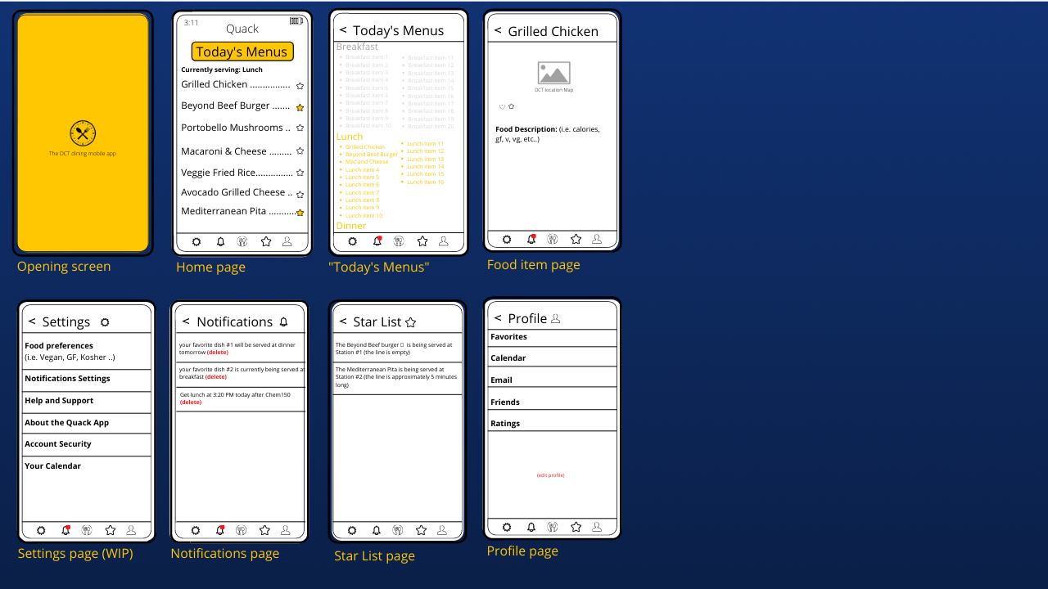
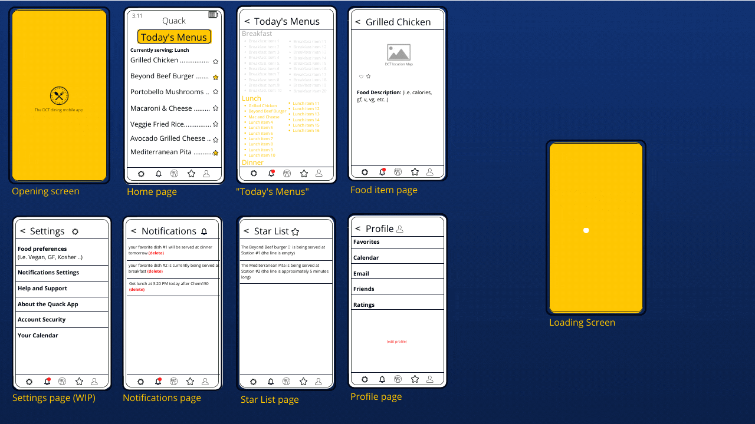
Old Paper
Prototype
Notes:
Mimi

Slide 8
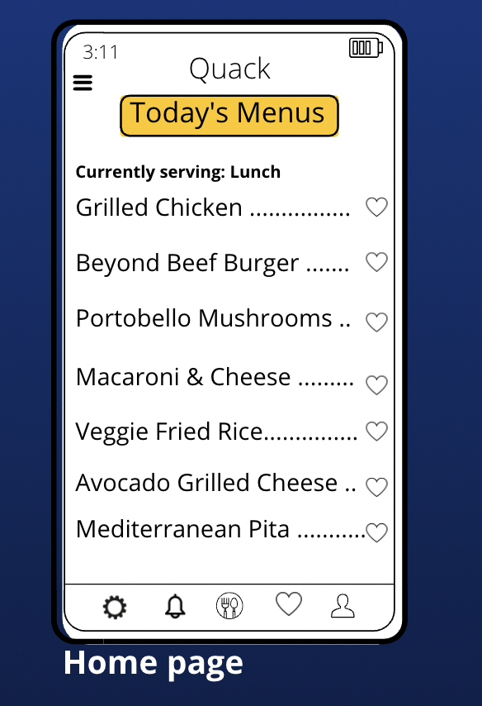
Paper Prototype
Old Version
Updated
Notes:
Mimi

Slide 9
Paper Prototype
Old Version
Updated
Notes:
mimi

Slide 10
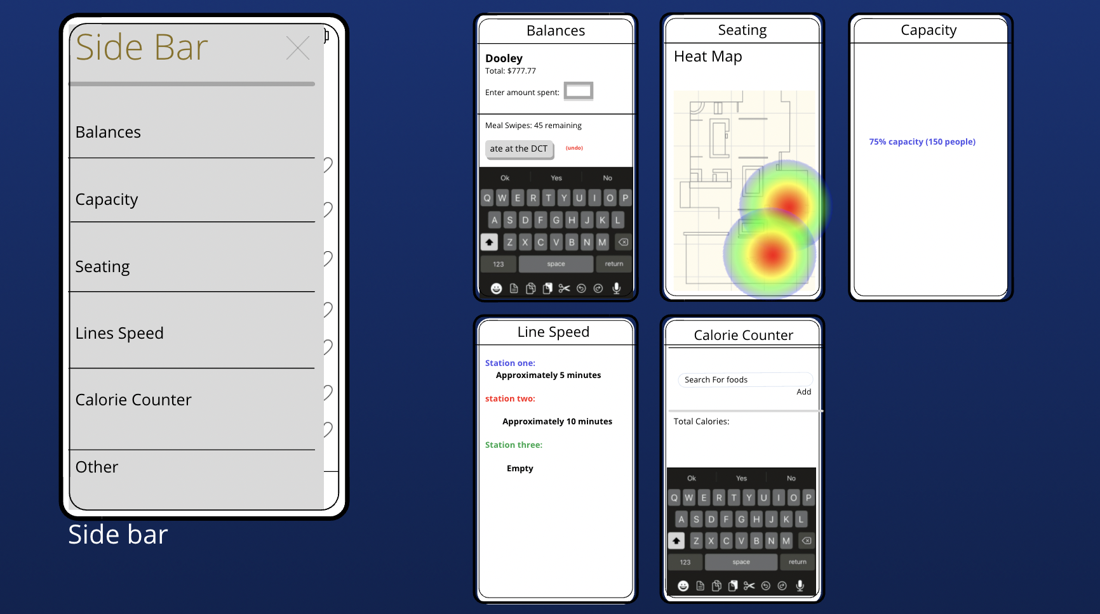
Paper Prototype (The sidebar) New additions
Notes:
mimi

Slide 11
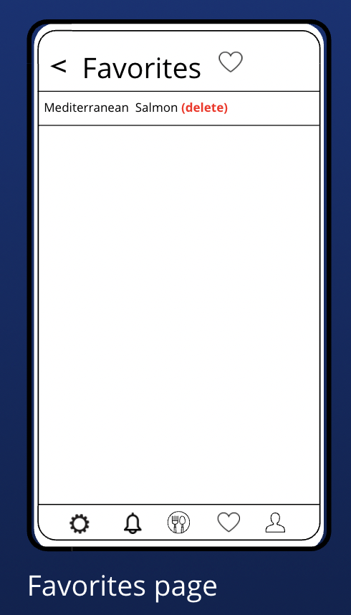
Paper Prototype (favorites)
Old Version
Old Version
Notes:
mimi

Slide 12
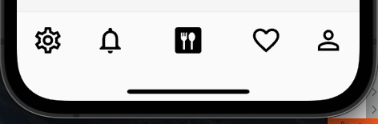
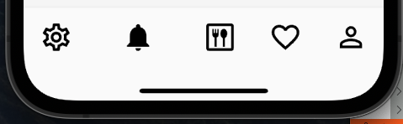
Navigation Bar
Implemented basic navigation bar
Reactive
Responsive
Notes:
Rafael

Slide 13
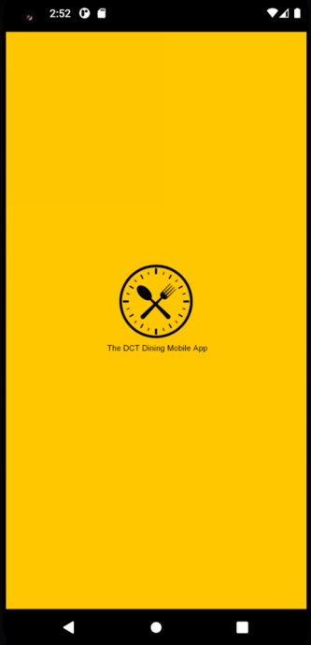
Splash Screen View
Initial screen when app is launched
Contains logo and general app description
Notes:
Ore

Slide 14
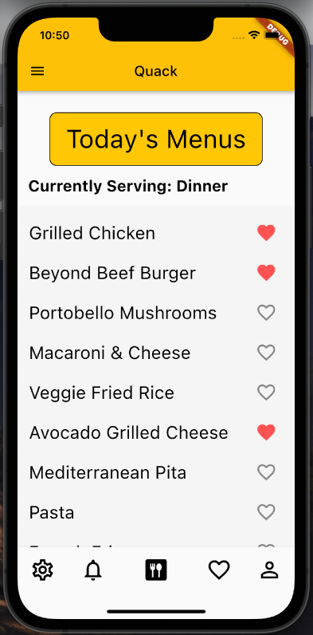
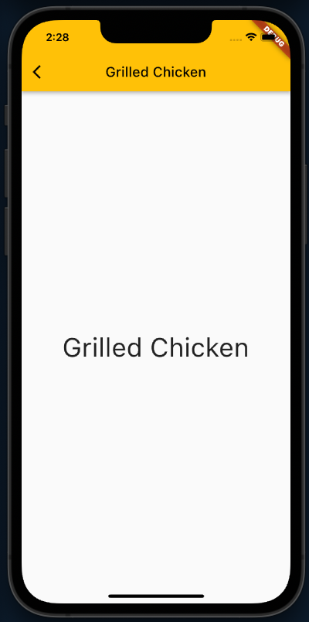
Home Screen View
Implemented basic layout
Responsive font size for all screen sizes
Scrollable box for all items
Selectable Items
Framework for favorite-able menu items
Static Hamburger Menu
Notes:
Rafael

Slide 15

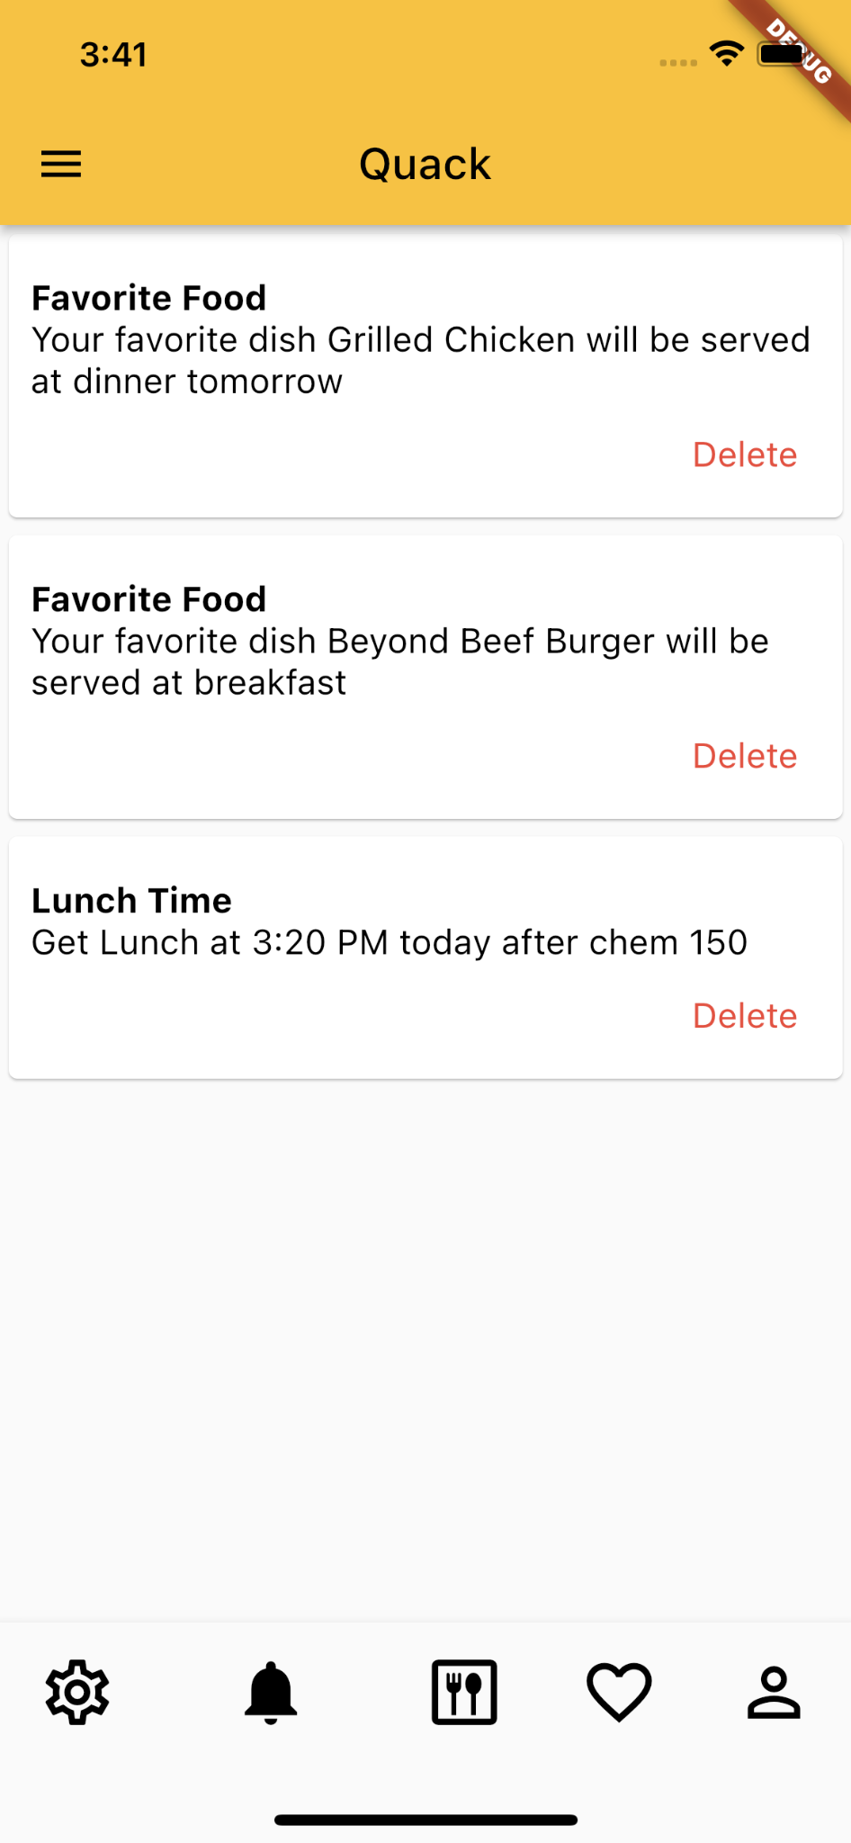
Notification view
One card for each notification
Deletion implementation
Scalable - Can easily add images, etc later
Notes:
David

Slide 16
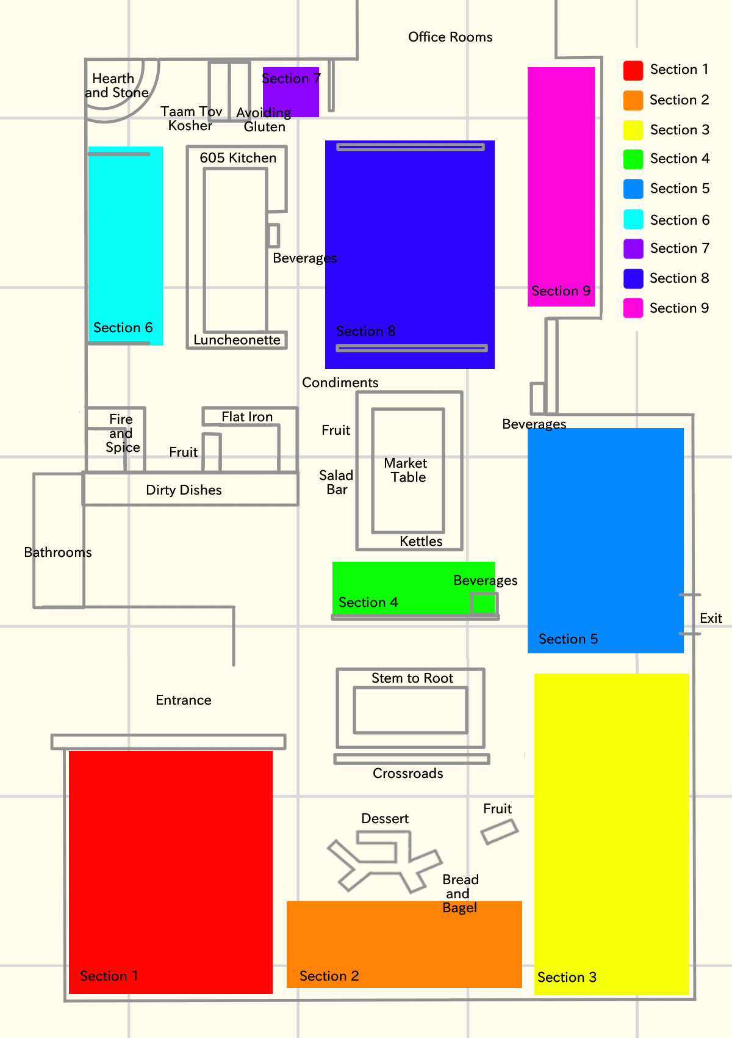
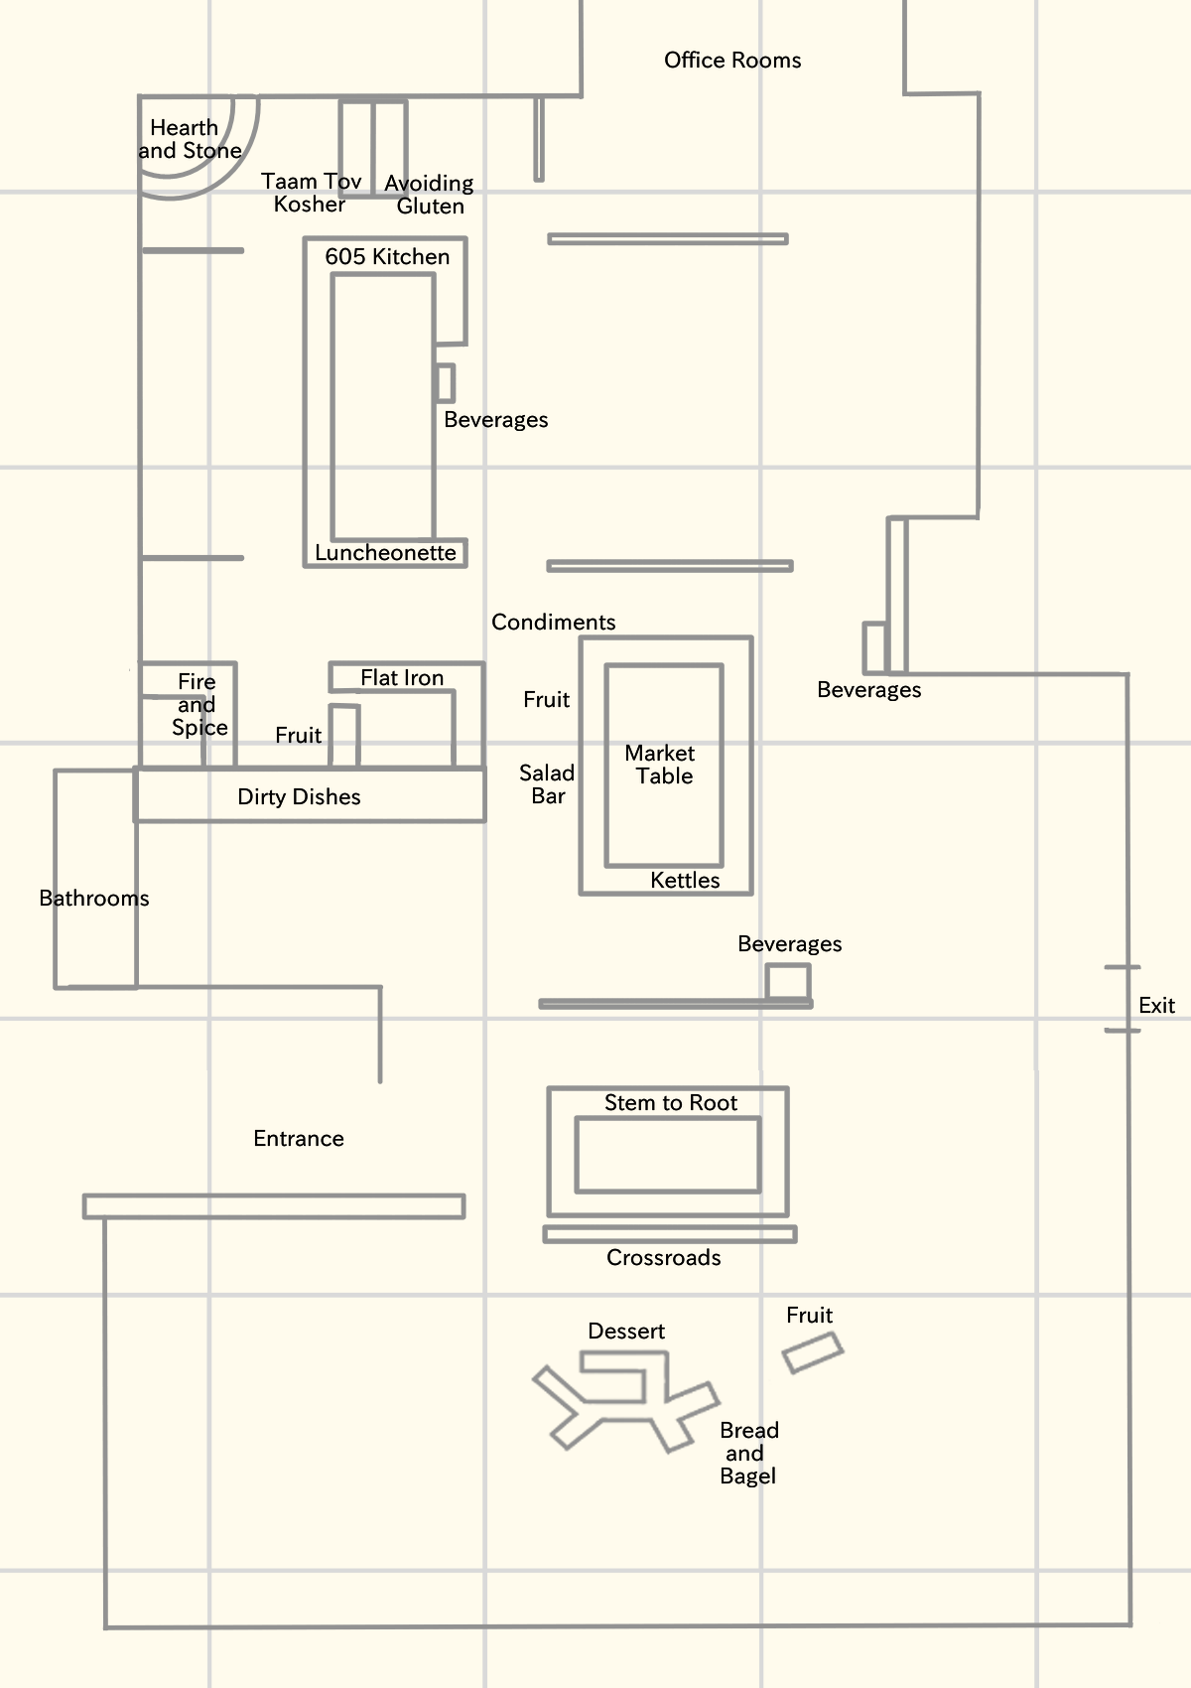
Notes:
Brenda
For our app we want to show the optimal path to your food as well as display the section your friend is sitting at so you know where to meet your friends. Here we have 2 maps. One shows all the seating sections and the food stations and the other shows only the food stations. - We are able to isolate any part so we can highlight section 1 seating or highlight the Hearth and Stone food station.

Slide 17
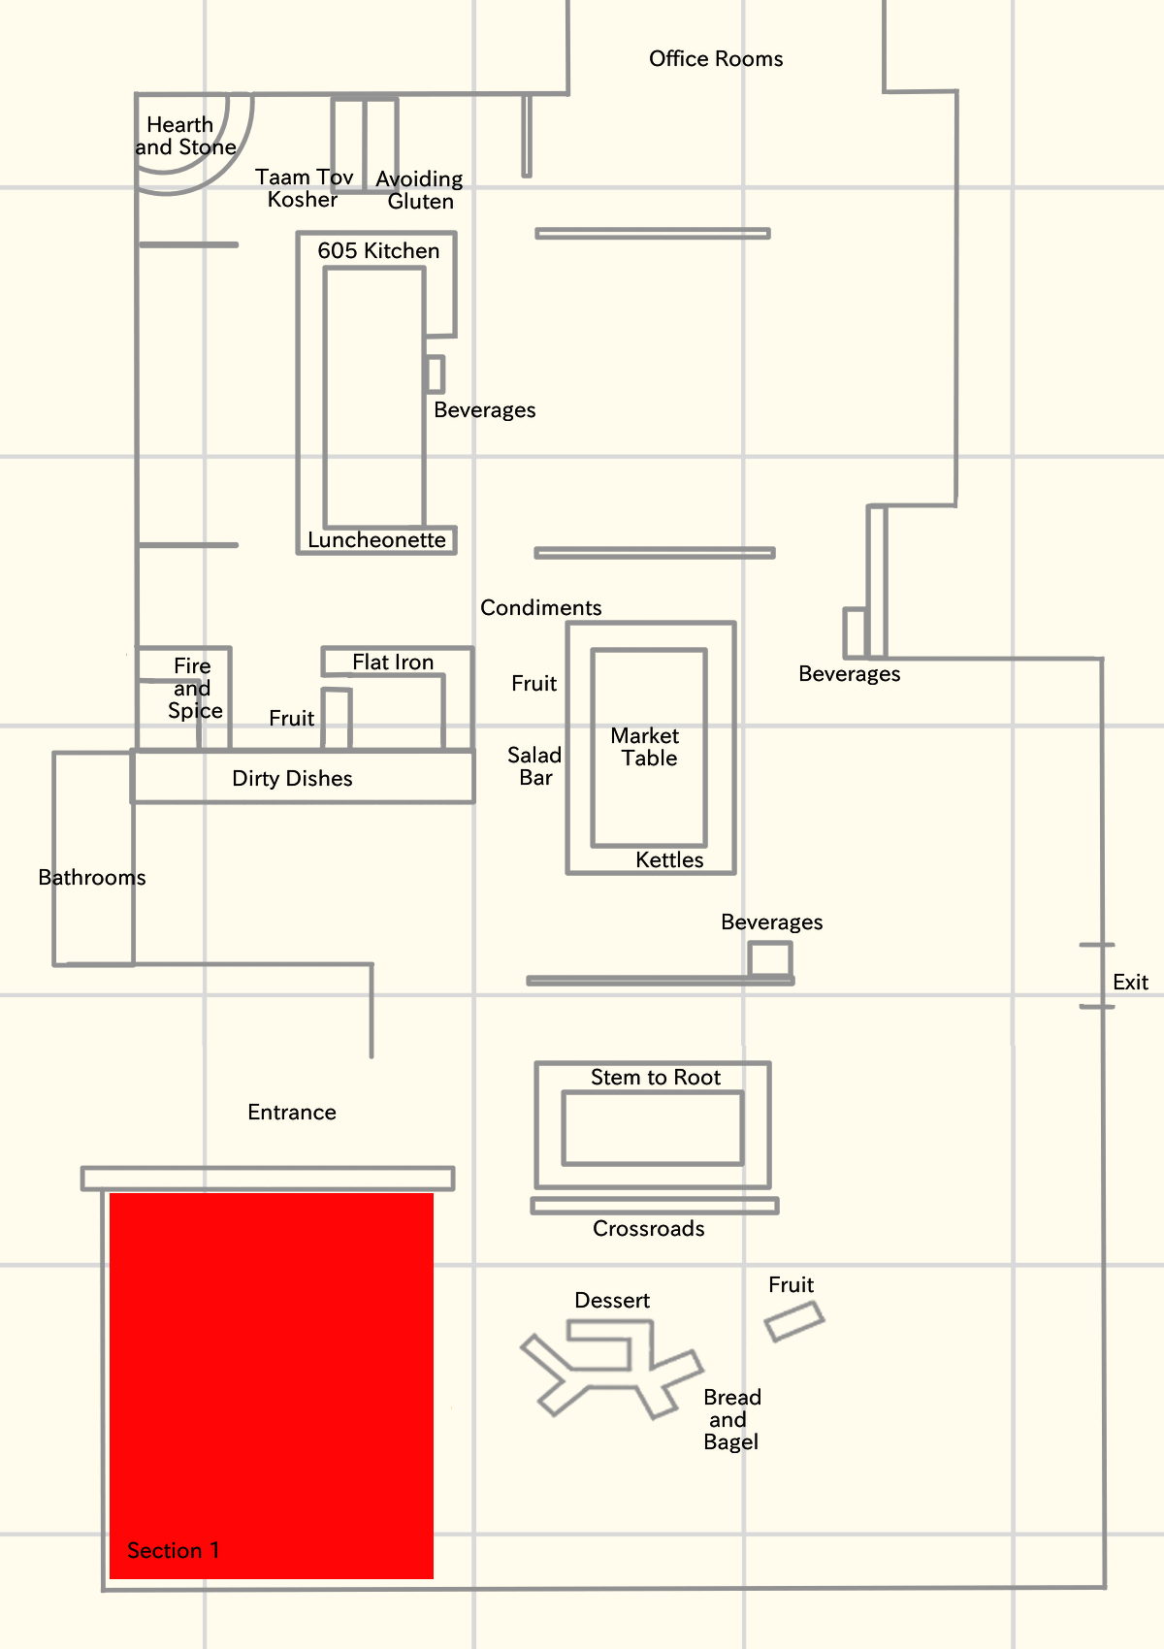
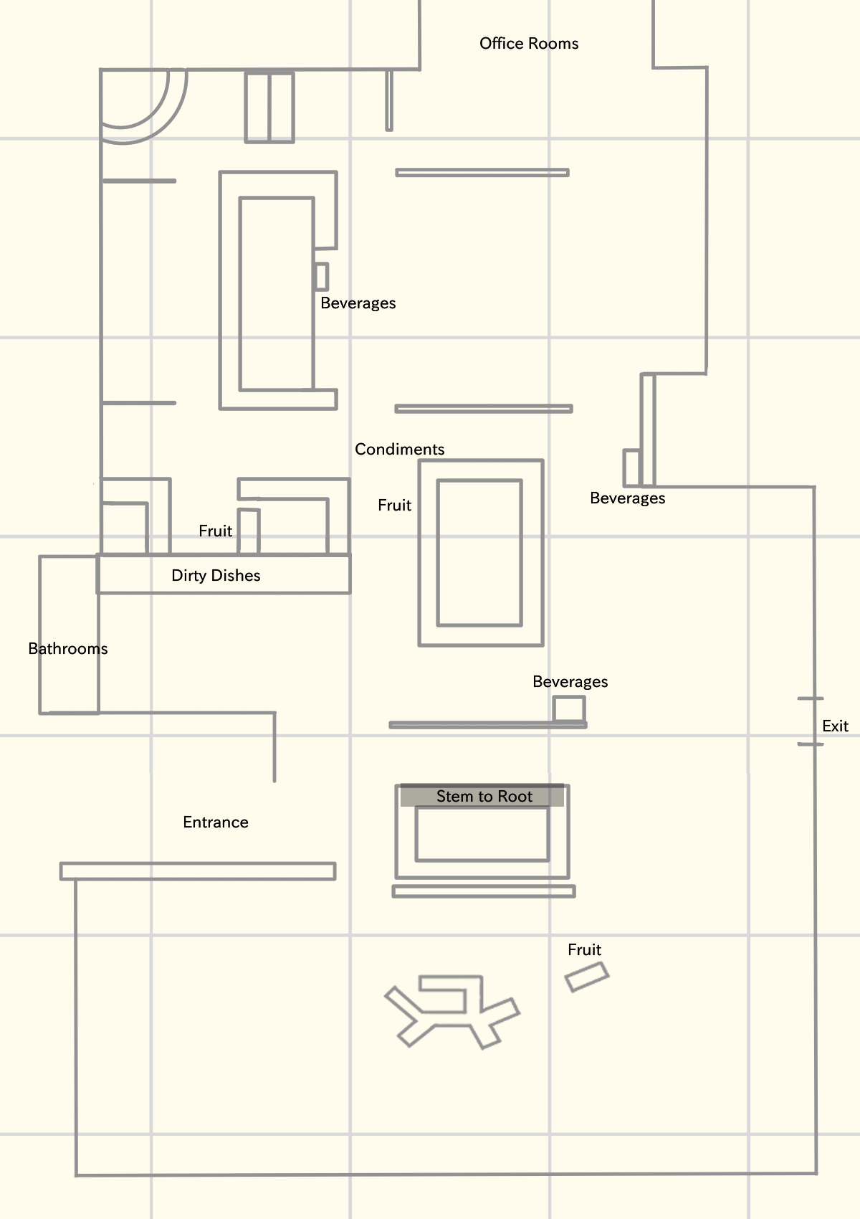
Notes:
Brenda
For our app we want to show the optimal path to your food as well as display the section your friend is sitting at so you know where to meet your friends. Here we have 2 maps. One shows all the seating sections and the food stations and the other shows only the food stations. We are able to isolate any part so we can highlight section 1 seating or highlight the Stem to Root food station.

Slide 18
02
Acknowledging feedback
Notes:
Brenda
Let’s acknowledge some feedback

Slide 19
Feature Suggestions
Specify which food items are Halal/Kosher/Vegan/etc
Line prediction might not be accurate/useful
Implementation
How will we get specific data?
How will we create for both IOS and Android?
What software and technology are we using?
Notes:
Brenda
For sprint 1 we got some suggestions for new features like specifying food item labels as well as got some feedback on features we planned to include in our app already like line prediction.
And we also noticed there was still confusion on how we will get our data, how we will create our apps, and what software and technology we planned on using.

Slide 20
Feature Suggestions
When the food is listed we plan to include:
Food name
Station name
Food label (Vegan, vegetarian, Halal, Kosher, etc)
Nutritional Value
Notes:
David

Slide 21
Implementation
Software we are using:
Flutter to create the app for IOS and Android
Cloud Database for our database
Backends in Python using FastAPI
Data we are retrieving:
Food information (from previous slide) by web scraping Bon Appetit
Dining Hall Capacity will be mocked
Line speed prediction will be mocked
Notes:
Rafael

Slide 22
03
What are our goals for the week?
Notes:
Miles

Slide 23
Point Value Examples
Logistics
Coding
1: Upload Slides to Dropbox
2: Organize Feedback for Retro
3: Calculate Scrum Velocity
5: Add new Feature Tickets
8: Apply for Hatchery Grant
13: N/A
21: Too Much
1: Loading Screen
2: Home Screen UI
3: Setup GitHub
5: <3 Screen
8: N/A
13: Web-scraping Bon Appetit
21: Too Much?
Notes:
Miles

Slide 24
Storytime: New Tickets Added
[2pts] Save Seated Section
[2pts] Save User New Friend
As a developer, I would like to have a helper method that saves the section a user sits in, so that this method can be reused.
As a developer, I would like to have a helper method that saves new friends, so that the method can be reused.
[2pts] Save Dooley Dollars
[2pts] Save User Login
As a developer, I would like to be able to store dooley dollar balances, so that this helper method can be reused.
As a developer, I would like to have a helper method that saves the user login, so that the method can be reused.
[2pts] Save New <3
[2pts] Save User Password
As a developer, I would like to have a helper method that saves new hearted items, so that the method can be reused.
As a developer, I would like to have a helper method that saves user password, so that the method can be reused.
Sprint 3 will be geared toward Backend Development
Notes:
Miles

Slide 25
THANKS
Please remember to share your feedback :)
Notes:
Miles

